Slide 1
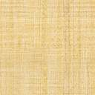
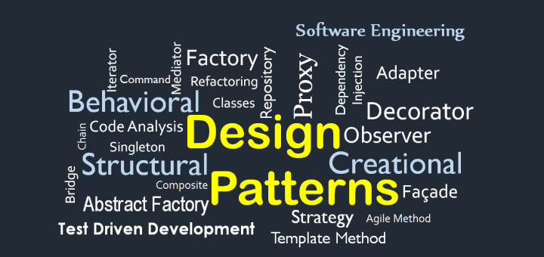
Software Design Patterns

Slide 2
What are design patterns?
Design patterns are used to represent some of the best practices adapted by experienced object-oriented software developers. A design pattern systematically names, motivates, and explains a general design that addresses a recurring design problem in object-oriented systems. It describes the problem, the solution, when to apply the solution, and its consequences.
Software design patterns are programming language independent and typically show relationships and interactions between classes and objects.
To see how general design patterns are, look at an architect or a civil engineer: when they want to construct a building, they don’t spend time designing elementary parts. Instead, they put elementary parts together, much like software developers do when they build applications.

Slide 3
What are the types of software design patterns?
There are mainly three types of software design patterns...
1. Creational
2. Structural
3. Behavioral

Slide 4
CREATIONAL
Creational design patterns revolve around class instantiation or object creation
They help make a system independent of how its objects are created, composed, and represented
Creational design patterns can be broken down further into two sub-types, those two being class-creational and object-creational design patterns
The main difference between the two is that class-creational patterns use inheritance to vary the class that’s instantiated, while object-creational patterns will delegate instantiation to other objects

Slide 5
Some creational pattern examples...
Abstract Factory – Creates an instance of several families of classes
Purpose: Provides an interface for creating families of related objects, without specifying concrete classes.
Factory method – creates an instance of several derived classes
Purpose: Lets a class defer instantiation to subclasses so that they can decide which class to instantiate
Prototype – A fully initialized instance to be copied or cloned
Purpose: Uses an instance of a class as a “breeder” for all future instances
Singleton – A class of which only a single instance can exist
Purpose: Encapsulates a shared resource within a unique class instance that can be accessed globally by the program

Slide 6
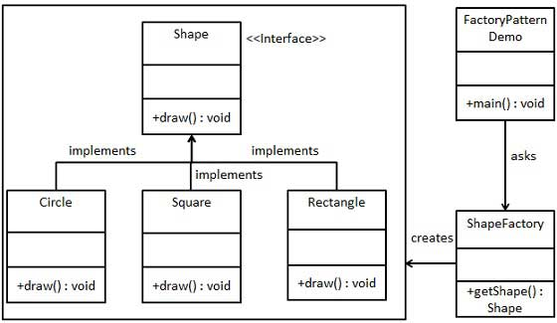
A closer look at factory
FactoryPatternDemo, our demo class will use ShapeFactory to get a Shape object. It will pass information (CIRCLE / RECTANGLE / SQUARE) to ShapeFactory to get the type of object it needs.

Slide 7
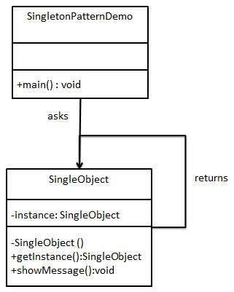
A closer look at singleton
SingleObject class provides a static method to get its static instance globally. SingletonPatternDemo, our demo class uses the SingleObject class to get a SingleObject object.

Slide 8
STRUCTURAL
Structural design patterns revolve around organizing different classes and objects to form larger structures and provide new functionalities
They are used to ease the design process by identifying a simple way to realize relationships between entities (object instances, classes, etc.)
Structural design patterns explain how to assemble objects and classes into larger structures while keeping these structures flexible and efficient.

Slide 9
Some Structural pattern examples...
Adapter: Match interfaces of different classes
Purpose: Allows objects with incompatible interfaces to collaborate
Bridge: Separates on object’s interface from its implementation
Purpose: Allows one to separate similar classes into separate hierarchies
Composite: A tree structure of simple and composite objects
Purpose: Allows one to work with structures within the tree as if they were individual structures
Decorator: Add responsibilities to objects dynamically
Purpose: Allows one to attach new behaviors to objects when needed without explicit addition

Slide 10
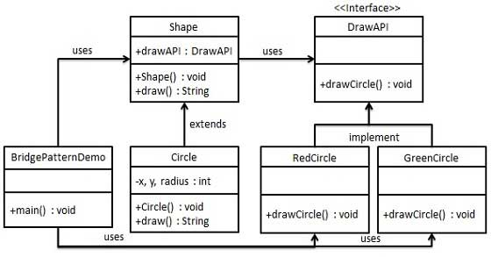
A closer look at bridge
We have a DrawAPI interface which is acting as a bridge implementer and concrete classes RedCircle, GreenCircle implementing the DrawAPI interface. Shape is an abstract class and will use object of DrawAPI. BridgePatternDemo, our demo class will use Shape class to draw different colored circles.

Slide 11
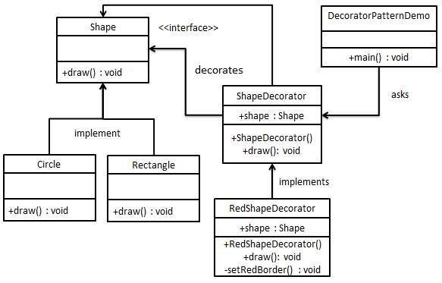
A closer look at Decorator
We're going to create a Shape interface and concrete classes implementing the Shape interface. We will then create an abstract decorator class ShapeDecorator implementing the Shape interface and having Shape object as its instance variable.
RedShapeDecorator is concrete class implementing ShapeDecorator.
DecoratorPatternDemo, our demo class will use RedShapeDecorator to decorate Shape objects.

Slide 12
BEHAVIORAL
Behavioral design patterns are all about identifying common communication patterns between objects and realizing these patterns
Behavioral patterns are concerned with the assignment of responsibilities between objects, or, encapsulating behavior in an object and delegating requests to it.
Behavioral design patterns increase flexibility in carrying out communication between different components of software

Slide 13
Some Behavioral pattern examples...
Chain of Responsibility: A way of passing a request between a chain of objects
Purpose: Objects that can handle the request at the current moment can choose to process or hand it off to the next object in the chain
Iterator: Allows one to traverse elements of a collection without exposing underlying implementation
Purpose: Allows the client to use iteration functionality without needing to know the data structure implementation or how it works
Mediator: Defines simple communication between objects
Purpose: Rather than having objects communicate directly (which can introduce a lot of chaotic dependencies), they communicate with each other via a mediator object
Visitor: Allows one to define a new operation without changing the classes of elements on which it operates
Purpose: Allows distinct and unrelated operations to be performed on objects without polluting the structure of the classes in which the objects are defined

Slide 14
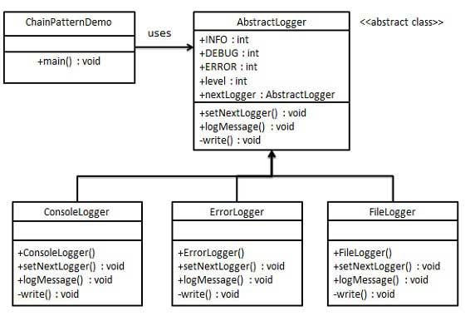
A closer look at chain of responsibility
We have created an abstract class AbstractLogger with a level of logging. Then we have created three types of loggers extending the AbstractLogger. Each logger checks the level of message to its level and print accordingly otherwise does not print and passes the message to its next logger.

Slide 15
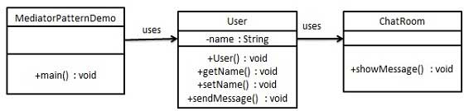
A closer look at mediator
We are demonstrating mediator pattern by example of a chat room where multiple users can send message to chat room and it is the responsibility of chat room to show the messages to all users. We have created two classes ChatRoom and User. User objects will use ChatRoom method to share their messages.

Slide 16
Now that I know about design patterns, I should implement them everywhere, right???
I’M NOT GONNA PUT A MEME HERE, BUT NO

Slide 17
THE KEY IS KNOWING THAT THEY EXIST AND NOTICING WHEN THEY WILL BENEFIT YOU
It’s important to note that, before you knew about software design patterns, you were writing code this whole time
In addition, software design patterns are based upon how developers NORMALLY would write code!
I think this is a good way to look at it: if you are working on a software project and run into a complex problem or have written very unusual, hard to understand code to solve a common problem, there is probably a design pattern for it
In conclusion, Implementing software design patterns give developers a way to create software efficiently, explain it concisely and implement their ideas regardless of programming language

